Slide 1
Composite Types
복합 타입

Slide 2
이 장에서 배울 수 있는 것
Arrays
Slices
Maps
Structs
JSON
Text and HTML Templates

Slide 3
배열(1)
var a [3]int // int 3개의 배열
for i, v := range a { fmt.Printf("%d %d\n", i, v) } for _, v := range a { fmt.Printf("%d\n", v) }
var q [3]int = [3]int{1, 2, 3} var r [3]int = [3]int{1, 2} // r[2]=0
q := [...]int{1, 2, 3} fmt.Printf("%T\n", q) // "[3]int"
type Currency int const ( USD Currency = iota EUR GBP RMB ) symbol := [...]string{USD: "$", EUR: "€", GBP: "!", RMB: "¥"} fmt.Println(RMB, symbol[RMB]) // "3 ¥"
q := [3]int{1, 2, 3} q = [4]int{1, 2, 3, 4}
// compile error: cannot assign [4]int to [3]int
r := [...]int{99: -1}
Notes:
// iota is a predeclared identifier representing the untyped integer ordinal // number of the current const specification in a (usually parenthesized) // const declaration. It is zero-indexed. const iota = 0 // Untyped int.

Slide 4
배열(2)
a := [2]int{1, 2} b := [...]int{1, 2} c := [2]int{1, 3} fmt.Println(a == b, a == c, b == c) // "true false false"
이러한 강타입 체크때문에 유연성이 떨어져서 함수 파라미터로 잘 사용하지 않는다. 대신 슬라이스를 사용한다.
c1 := sha256.Sum256([]byte("x")) c2 := sha256.Sum256([]byte("X")) fmt.Printf("%x\n%x\n%t\n%T\n", c1, c2, c1 == c2, c1) // [32]uint8
func zero(ptr *[32]byte) { for i := range ptr { ptr[i] = 0 } }
func zero(ptr *[32]byte) { *ptr = [32]byte{} }

Slide 5
슬라이스(1)
[] T 라고 선언
배열의 원소들 일부(또는 전부)에 접근할 수 있는 경량 자료 구조
구성요소
pointer
length
capacity

Slide 6
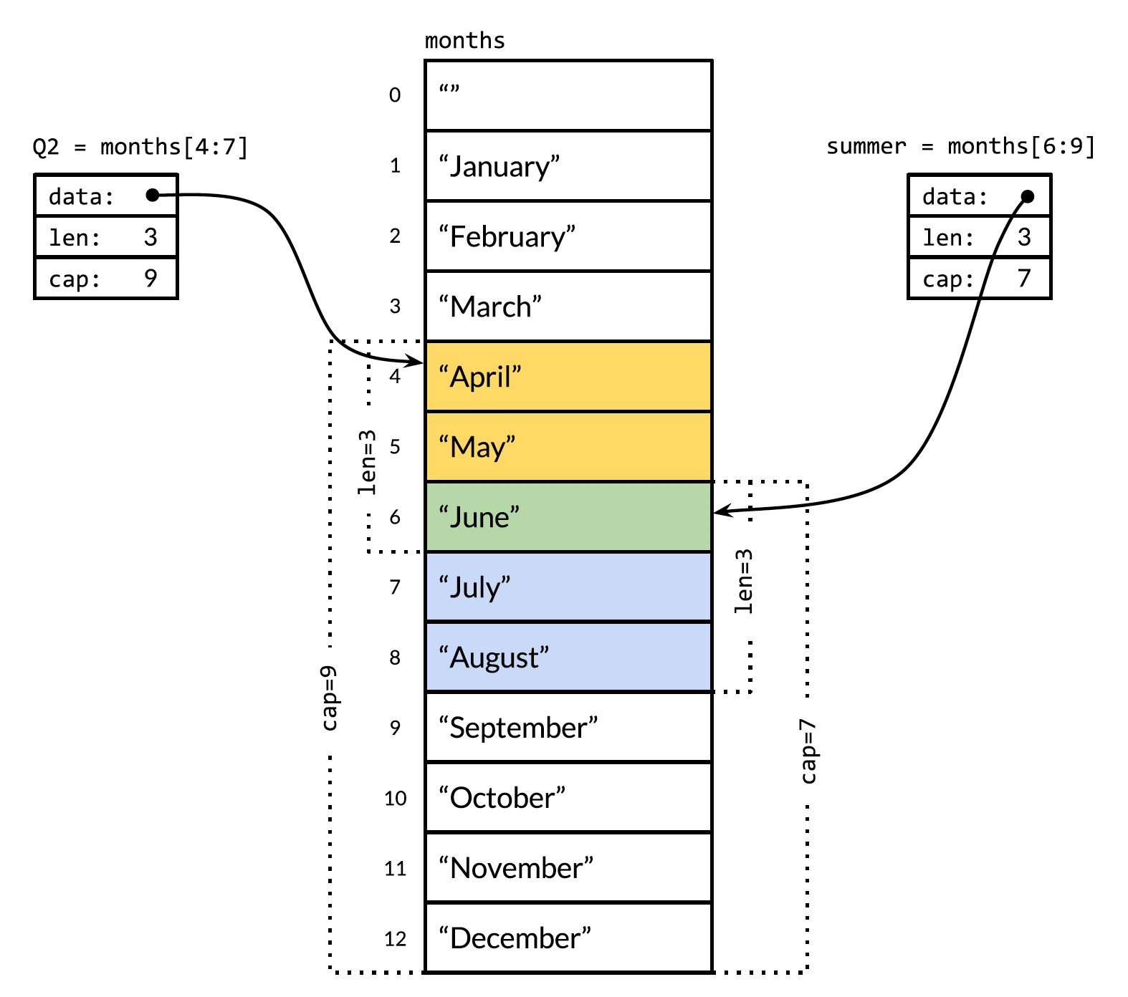
슬라이스(2)
months := [...]string{1: "January", /* ... */, 12: "December"}
Q2 := months[4:7] summer := months[6:9] fmt.Println(Q2) // ["April" "May" "June"] fmt.Println(summer) // ["June" "July" "August"]
fmt.Println(summer[:20]) // panic: out of range endlessSummer := summer[:5] // extend a slice (within capacity) fmt.Println(endlessSummer) // "[June July August September October]"

Slide 7
슬라이스(3)
func reverse(s []int) { for i, j := 0, len(s)-1; i < j; i, j = i+1, j-1 { s[i], s[j] = s[j], s[i] } }
a := [...]int{0, 1, 2, 3, 4, 5} reverse(a[:]) fmt.Println(a) // "[5 4 3 2 1 0]"
s := []int{0, 1, 2, 3, 4, 5} // Rotate s left by two positions. reverse(s[:2]) reverse(s[2:]) reverse(s) fmt.Println(s) // "[2 3 4 5 0 1]"

Slide 8
슬라이스(4)
슬라이스에 유일하게 허용된 비교 if summer == nil { /* ... */ }
슬라이스를 생성하는 또 다른 방법
make([]T, len) make([]T, len, cap) // same as make([]T, cap)[:len] 어떤 배열을 참조할까?
var s []int // len(s) == 0, s == nil s = nil // len(s) == 0, s == nil s = []int(nil) // len(s) == 0, s == nil s = []int{} // len(s) == 0, s != nil 슬라이스가 비어있는지 확인하려면??

Slide 9
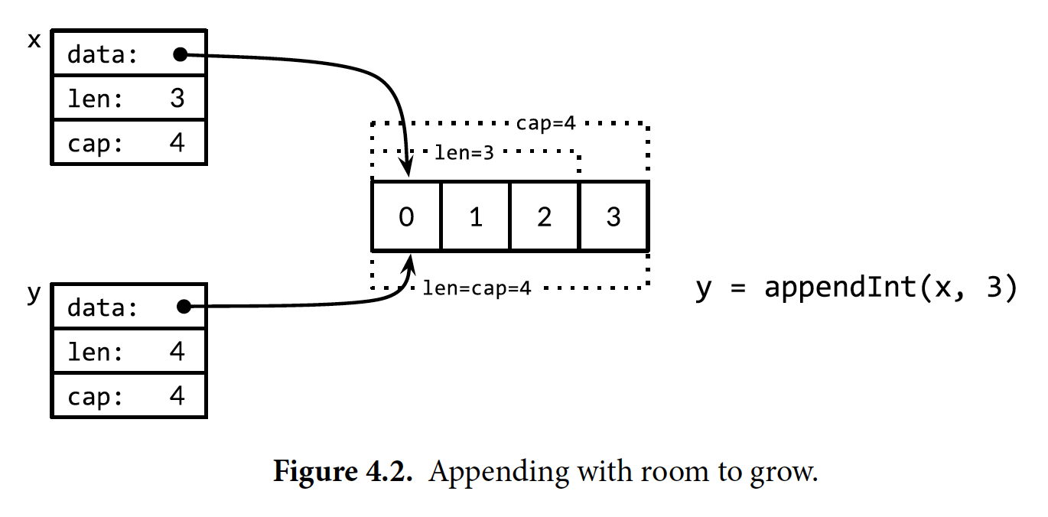
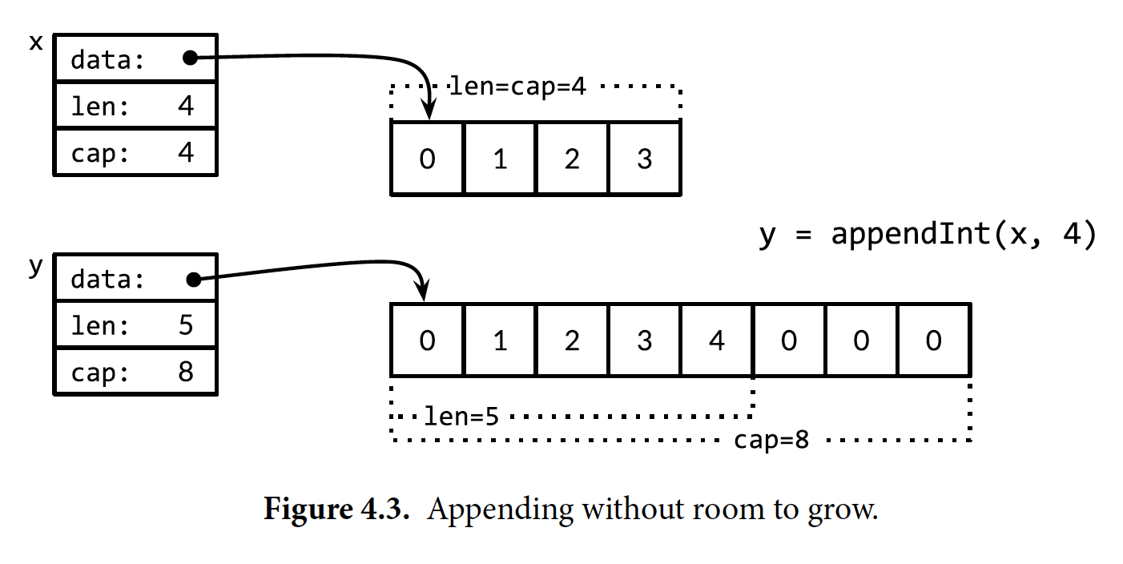
슬라이스(5) - append
func main() {
var x, y []int
for i := 0; i < 10; i++ {
y = append(x, i)
fmt.Printf("%d cap=%d\t%v\n", i, cap(y), y)
x = y
}
}
0 cap=1 [0] 1 cap=2 [0 1] 2 cap=4 [0 1 2] 3 cap=4 [0 1 2 3] 4 cap=8 [0 1 2 3 4] 5 cap=8 [0 1 2 3 4 5] 6 cap=8 [0 1 2 3 4 5 6] 7 cap=8 [0 1 2 3 4 5 6 7] 8 cap=16 [0 1 2 3 4 5 6 7 8] 9 cap=16 [0 1 2 3 4 5 6 7 8 9]

Slide 10
맵(1)
map[K]V K는 == 로 비교할 수 있어야 한다.
fmt.Println(ages["alice"]) // "31"
delete(ages, "alice") // remove element ages["alice"]
ages := map[string]int{
"alice": 31,
"charlie": 34,
}
ages["bob"] = ages["bob"] + 1 // happy birthday!
or ages["bob"] += 1
or ages["bob"]++
_ = &ages["bob"] // compile error: cannot take address of map element
ages := make(map[string]int)
or
ages := map[string]int{}
ages["alice"] = 31
ages["charlie"] = 34

Slide 11
맵(2)
for name, age := range ages { fmt.Printf("%s\t%d\n", name, age) } var names []string for name := range ages { names = append(names, name) }
ages := map[string]int{ "alice" : 0, } fmt.Println(ages["alice"]) // 0 fmt.Println(ages["bob"]) // 0 why???
맵에 유일하게 허용된 비교 if ages == nil { /* ... */ }
if age, ok := ages["bob"]; ok { fmt.Println("bob's age is ", age) } else { fmt.Println("no one") }
var ages map[string]int fmt.Println(ages == nil) // "true" fmt.Println(len(ages) == 0) // "true" ages["carol"] = 21 // panic

Slide 12
맵(3)
맵 활용 1 : Set타입은 없지만…
seen := make(map[string]bool) // a set of strings
맵 활용 2 : slice, map은 key로 사용 할 수 없지만...
var m = make(map[string]int) func k(list []string) string { return fmt.Sprintf("%q", list) } func Add(list []string) { m[k(list)]++ } func Count(list []string) int { return m[k(list)] }
맵 활용 3 : 값 타입을 복합타입으로...
var graph = make(map[string]map[string]bool)

Slide 13
구조체(1)
type Employee struct {
ID int
Name string
Address string
DoB time.Time
Position string
Salary int
ManagerID int
}
var dilbert Employee
필드 순서 중요 - 순서가 바뀌면 다른 타입으로 인식
필드 이름이 대문자 - 외부 export
자기자신을 필드로 사용할 수 없다. 단, 포인터는 가능
혹은 Name, Address string
type tree struct { value int left, right *tree }
구조체의 제로 값은 각 필드의 제로 값
dilbert.Salary -= 5000 var employeeOfTheMonth = &dilbert employeeOfTheMonth.Position += " (proactive team player)"

Slide 14
구조체(2)
type Point struct{ X, Y int }
p := Point{1, 2}
p := Point{Y: 2, X: 1}
pp := &Point{1, 2}
pp := new(Point)
*pp = Point{1, 2}
package p type T struct{ a, b int } // not exported
package q import "p" var _ = p.T{a: 1, b: 2} // compile error: can't reference a, b var _ = p.T{1, 2} // compile error: can't reference a, b
type Point struct{ X, Y int } p := Point{1, 2} q := Point{2, 1} fmt.Println(p == q) // "false"
func Scale(p Point, factor int) Point { return Point{p.X * factor, p.Y * factor} }
func Bonus(e *Employee, percent int) int { return e.Salary * percent / 100 }
hits := make(map[Point]int)

Slide 15
구조체(3)
type Point struct {
X, Y int
}
type Circle struct {
Center Point
Radius int
}
type Wheel struct {
Circle Circle
Spokes int
}
type Circle struct {
Point
Radius int
}
type Wheel struct {
Circle
Spokes int
}
w = Wheel{8, 8, 5, 20} // compile error
w = Wheel{X: 8, Y: 8, Radius: 5, Spokes: 20} // compile error
w = Wheel{Circle{Point{8, 8}, 5}, 20} // ok
w = Wheel{ // ok
Circle: Circle{
Point: Point{X: 8, Y: 8},
Radius: 5,
},
Spokes: 20,
}
var w Wheel
w.Circle.Center.X = 8
w.Circle.Center.Y = 8
w.Circle.Radius = 5
w.Spokes = 20
var w Wheel
w.X = 8 // equivalent to w.Circle.Point.X = 8
w.Y = 8 // equivalent to w.Circle.Point.Y = 8
w.Radius = 5 // equivalent to w.Circle.Radius = 5
w.Spokes = 20

Slide 16
JSON(1)
[ [ { "Title": "Casablanca", "released": 1942, "Actors": [ "Humphrey Bogart", "Ingrid Bergman" ] }, { "Title": "Cool Hand Luke", "released": 1967, "color": true, "Actors": [ "Paul Newman" ] }, { "Title": "Bullitt", "released": 1968, "color": true, "Actors": [ "Steve McQueen", "Jacqueline Bisset" ] } ]]
type Movie struct { Title string Year int `json:"released"` Color bool `json:"color,omitempty"` Actors []string } var movies = []Movie{ {Title: "Casablanca", Year: 1942, Color: false, Actors: []string{"Humphrey Bogart", "Ingrid Bergman"}}, // ... }
data, err := json.Marshal(movies) 혹은
data, err := json.MarshalIndent(movies, "", " ") if err != nil { log.Fatalf("JSON marshaling failed: %s", err) } fmt.Printf("%s\n", data)

Slide 17
JSON(2)
type IssuesSearchResult struct { TotalCount int `json:"total_count"` Items []*Issue }
type Issue struct { Number int HTMLURL string `json:"html_url"` Title string State string User *User CreatedAt time.Time `json:"created_at"` Body string // in Markdown format }
type User struct { Login string HTMLURL string `json:"html_url"` }
...
var result IssuesSearchResult if err := json.NewDecoder(resp.Body).Decode(&result); err != nil { resp.Body.Close() return nil, err }
…
fmt.Printf("%d issues:\n", result.TotalCount) for _, item := range result.Items { fmt.Printf("#%5d%9.9s %.55s\n", item.Number, item.User.Login, item.Title) }
13 issues: #5680 eaigner encoding/json: set key converter on en/decoder #6050 gopherbot encoding/json: provide tokenizer #8658 gopherbot encoding/json: use bufio #8462 kortschak encoding/json: UnmarshalText confuses json.Unmarshal #5901 rsc encoding/json: allow override type marshaling #9812 klauspost encoding/json: string tag not symmetric #7872 extempora encoding/json: Encoder internally buffers full output
...

Slide 18
Template - Text
const templ = `{{.TotalCount}} issues: {{range .Items}}---------------------------------------------------
Number:{{.Number}} User: {{.User.Login}} Title: {{.Title | printf "%.64s"}} Age: {{.CreatedAt | daysAgoFunc}} days {{end}}`
32 issues: ----------------------------------------- Number: 29688 User : sheerun Title : proposal: encoding/json: add InputOffset to json decoder Age : 18 days ----------------------------------------- Number: 29686 User : sheerun Title : json: Add InputOffset for stream byte offset access Age : 18 days ----------------------------------------- Number: 29035 User : jaswdr Title : proposal: encoding/json: add error var to compare the returned Age : 60 days ...
func daysAgo(t time.Time) int {
return int(time.Since(t).Hours() / 24)
}
var report = template.Must(template.New("issuelist"). // 템플릿 생성
Funcs(template.FuncMap{"daysAgoFunc": daysAgo}). // 접근 가능 함수목록
Parse(templ)) // 파싱
func main() {
result, err := github.SearchIssues(os.Args[1:])
if err != nil {
log.Fatal(err)
}
if err := report.Execute(os.Stdout, result); err != nil {
log.Fatal(err)
}
}

Slide 19
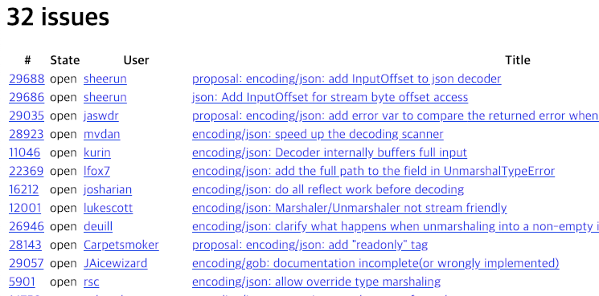
Template - HTML
var issueList = template.Must(template.New("issuelist").Parse(`
<h1>{{.TotalCount}} issues</h1>
<table>
<tr style='textalign:left'>
<th>#</th>
<th>State</th>
<th>User</th>
<th>Title</th>
</tr>
{{range .Items}}
<tr>
<td><a href='{{.HTMLURL}}'>{{.Number}}</td>
<td>{{.State}}</td>
<td><a href='{{.User.HTMLURL}}'>{{.User.Login}}</a></td>
<td><a href='{{.HTMLURL}}'>{{.Title}}</a></td>
</tr>
{{end}}
</table>
`))
…
issueList.Execute()

